Slide 1

Context-Aware
Dialog Re-Ranking
For
Task Oriented Dialog Systems
AI 2-2팀
한건수 연구원
2019. 6. 26
Copyright© 2018 TmaxData. All Rights Reserved.

Slide 2
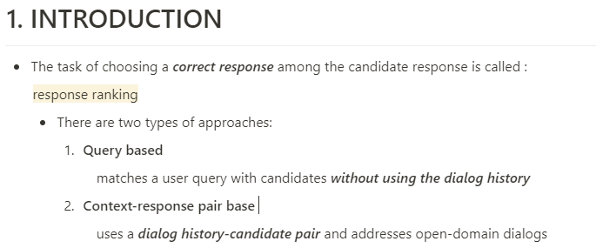

Slide 3
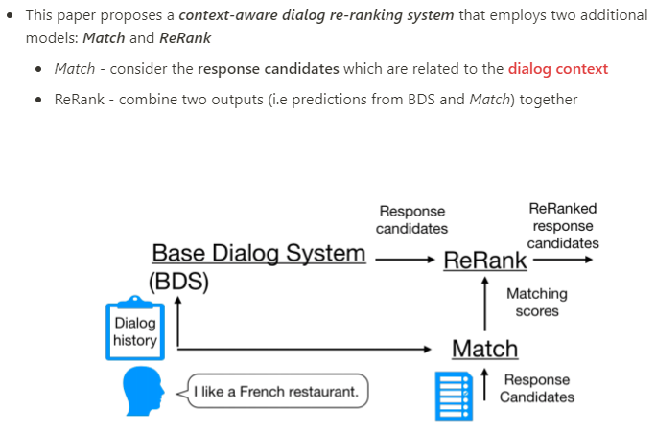
BDS는 dialog history와 User query를 고려해
Candidate response 찾고,
Match는 그 response를 이용해
Matching score를 계산

Slide 4
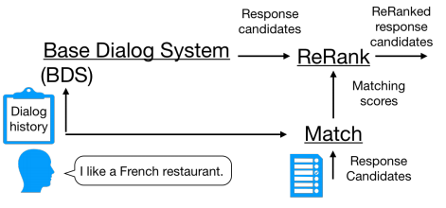
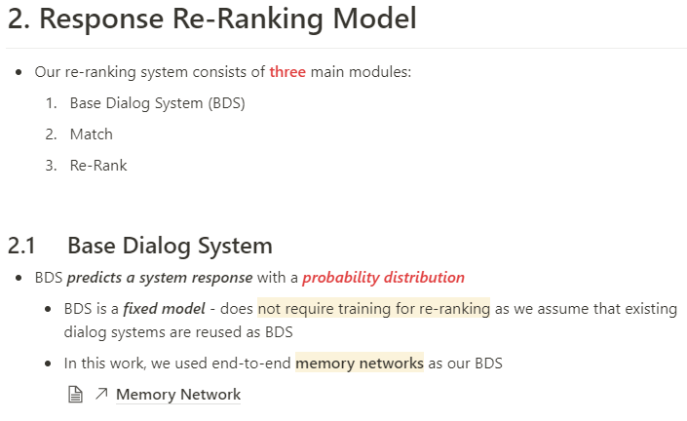
http://solarisailab.com/archives/690

Slide 5
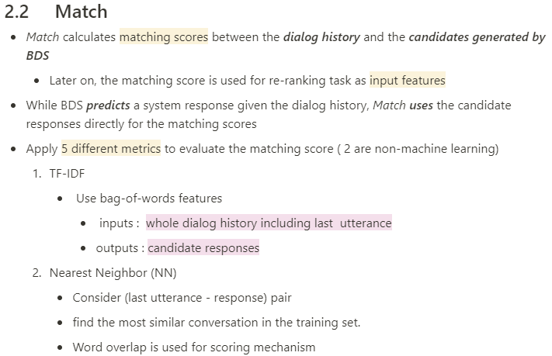

Slide 7
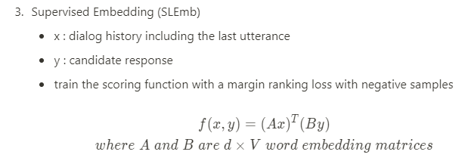

Slide 8
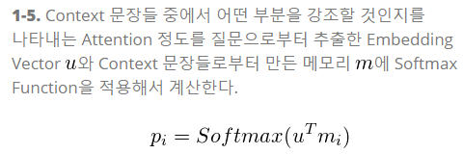
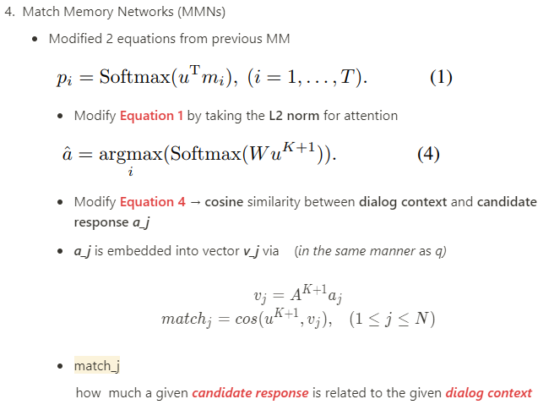


Slide 9
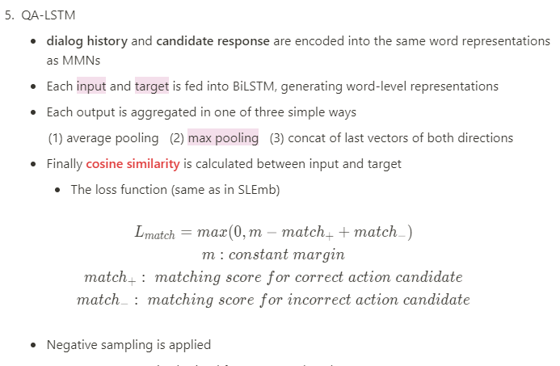
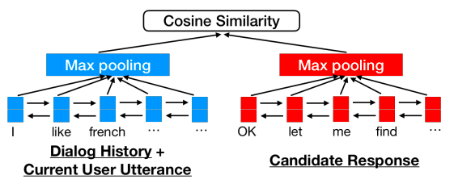

Slide 10
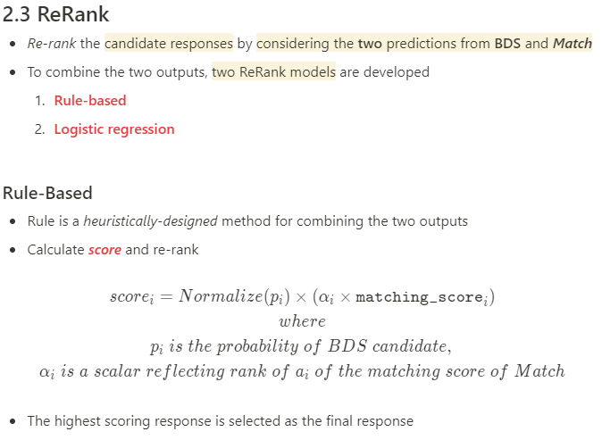

Slide 11


Slide 12
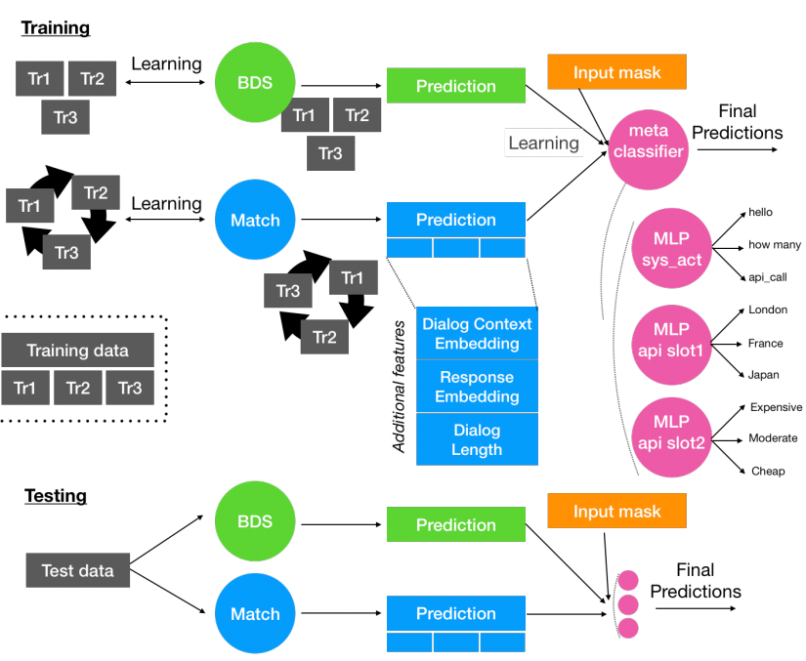
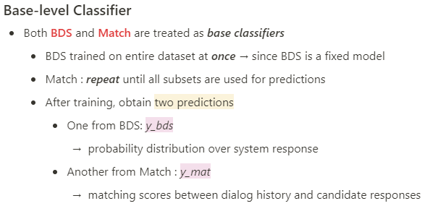
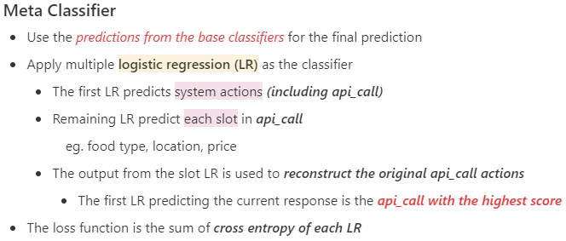

Slide 14
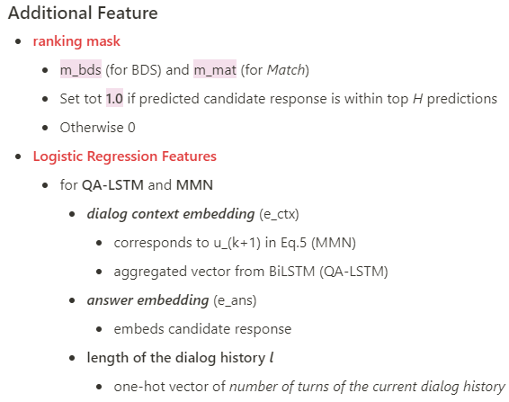

Slide 15
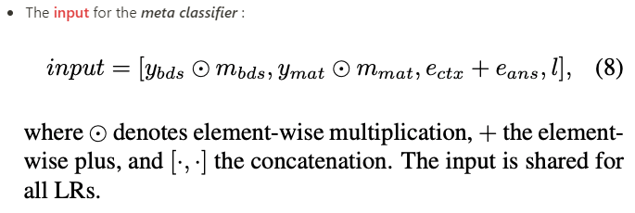

Slide 16
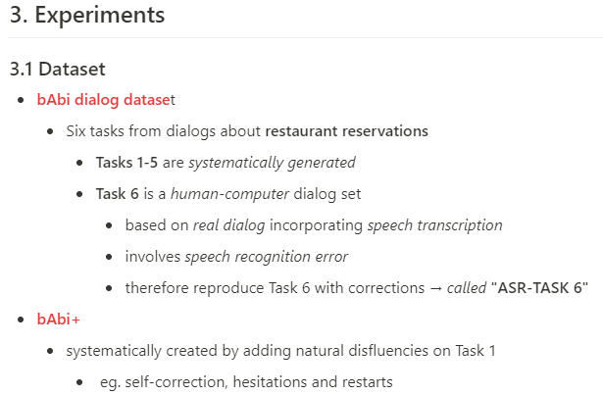

Slide 17
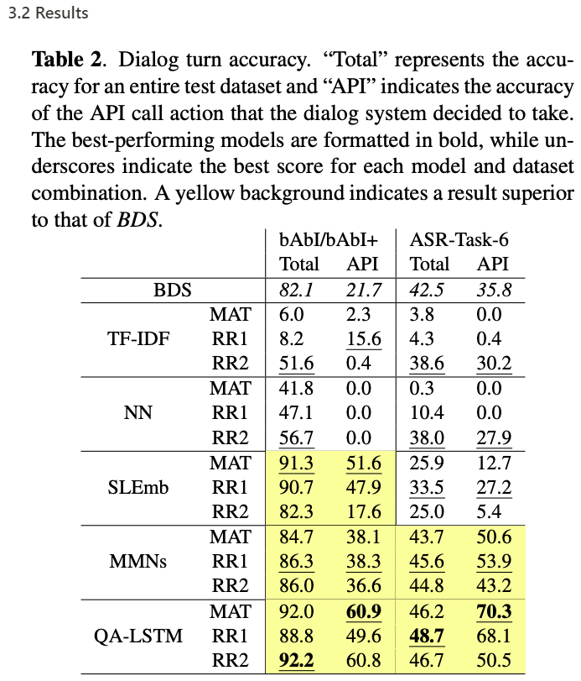

bAbI/bAbI+
- re-ranker was trained on the bAbI dialog Task 1 and tested on the bAbI+ dataset
ASR Task-6
- re-ranker was trained on newly created ASR Task -6

Slide 18
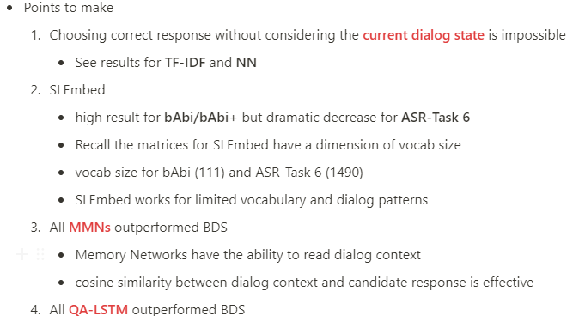

Slide 22
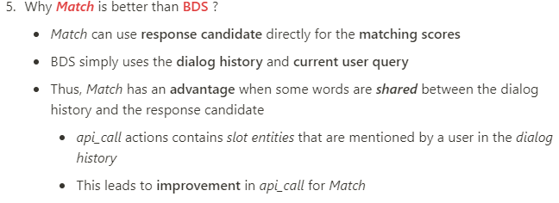

Slide 23
